Slide 1
NextGen Sequencing BIFX-550
Relevant Book Chapter is 9
S. Ravichandran, Ph.D. Biology,
Hood College, Frederick, MD 21701

Slide 2
Learning Objectives
Eukaryotic Chromosome
We will talk about DNA Sequencing.
How NGS data is generated?
What are FASTQ,SAM/BAM and VCF file formats?
How NGS data is aligned to a reference genome?
Genetic variants and how are they determined?
Types of errors associated with alignment
Impact assessment of genomic variants

Slide 3
Eukaryotic Chromosome
Prokaryotes and Eukaryotes
Nucleus lacking and with Nucleus
Chromosomes
C-value
# of DNA bases of DNA or picograms of DNA 1pg = 1Mbases
We see that complexity is not related to amount of DNA (C-value paradox)
Human (3.3 Gb) vs Onion (15 Gb)

Slide 4
ENCODE
ENOCDE project was set up to answer the C-value paradox
Addressed several important questions
What is a function?
“A specific and reproducible biochemical phenomenon must have a biologically meaningful function” Eddy
BioMart/Bioconductor are good package to explore genomic data

Slide 5
Repeats/gene structure/genes
Mammals
About 60% of genomic DNA are repeats
Repeats have been identified with disease
Key to understand why we have them or why they arise?
Book talks about several types of repeats
Book also talks about different types of genes
Pseudo genes etc.
Let us look at the gene structure in humans

Slide 6
LCT Controlled by upstream sequences
Activator
Distal Control Elements
Proximal Control Elements
DNA
Terminator
Exon
Intron
Exon
Intron
Exon
Enhancer
Silencers
Promoter
Repressor
TATA Box
Coding region
(~ -30 bp)
A mutation in the non-coding region causes the LCT to remain turned on after childhood (lactose persistence)
~ 800 bp upstream
Note only 2% of our genome are coding regions. But, ~80% of non-coding have some functional role (ex. transcription, etc.)
Note that TATA sequence is a consensus sequence (some genes do not have the exact same motif stretch)

Slide 7
CpG islands/Synteny
CpG means CG bases connected by phospho diester bond
Also Cytosines in CpG can methylated to form 5-methylcytosine
Methylating a C within a gene can impact its expression
In mammals 70-80% of CpG cytosines are methylated

Slide 8
I will demonstrate how to use expression data in NCBI and later via R
Blackboard: under Class-10 will have all the files under hands-on folder
(will be available on the class day)

Slide 9
Sequencing
Human Genome Project
Shotgun
https://www.youtube.com/watch?v=vg7Y5EeZsjk
Other sequencing
Genome Wars
Craig Venter (Celera founder, J. Craig Venter Institute)
Francis Collins (NIH Director)

Slide 10
NGS Applications
Whole genome sequencing for any species
Build or rebuild the tree of life
HGP (mosaic)
We can re-sequence the individual's genome
Genomes from individual cells within an individual
Cancer to non-cancerous cells
Somatic not sex cells

Slide 11
Applications
RNA-seq
RNA transcript levels-gene expression
ChIP-Seq
Identify DNA sequence regions of TF binding sites

Slide 12
What sequences are of our interest?
Whole genome
Leaving out the repetitive (difficult for sequencing)
Exons that comprise < 3% of genome
Intergenic and introns and exons of a gene
Exome sequencing
All the exons of the genome
~20K protein-coding human genes

Slide 13
Sanger Sequencing

Slide 14
Basic Steps
Dideoxynucleotide sequencing
Obtain a template (DNA)
Denature to get a single strand DNA
Primer (20 nts complementary to the strand being sequenced)
DNA Polymerase
4 dNTPs

Slide 15
2′-deoxynucleotides (dNTPs) for extension, For example, 2′-deoxythymidine triphosphate dideoxynucleotide (ddNTP) for inhibition. For example, 2′,3′-dideoxythymidine triphosphate

Slide 16
This was initially used in the HGP (more on this later)
No 3-OH group, so extension will halt

Slide 17
Sanger Sequencing Pre next-gen or First-gen sequencing
Sequencing Reaction
DNA chain grow only from 3’ end
5’ GTACGG ..3’
Primer
3’ CATGCCATCGGGGCATGG ..5’ Template
Fluoresenct Labelled for ddNTP (chain terminating) nucleotides
dATP
A
dCTP
DNA Polymerase
C
T
A
T
A
A
G
C
A
C
G
A
A
A
T
C
T
C
C
T
Free Bases
C
A
C
A
A
G
C
T
A
A
G
G
C
T
A
G
C
T

Slide 18
ddCTP focused reaction
3’- CATGCCATCGGGGCATGG -5’ Template
5’- GTACGG -3’
Primer
DNA chain grow only from 3’ end
5’- GTACGGTAGC -3’ 5’- GTACGGTAGCC -3’
5’- GTACGGTAGCCC -3’
5’- GTACGGTAGCCCCGTAC -3’ 5’- GTACGGTAGCCCCGTACC -3’
If you are using ddCTP dideoxyribonucleic nucleotide triphosphate These are chain-terminating nucleotides. Once added they cannot extend the chain

Slide 19
Sequencing Reaction Products
GTACGGT
GTACGGTA
PRIMER 5’ GTACGG 3’
GTACGGTAG
dNTPs
GTACGGTAGC
G
C
PLUS Free Bases
A
T
GTACGGTAGCC
GTACGGTAGCCC
Handle 500-800 bases long
Sequencing runs out of steam roughly after about 800 bases.
3’ -CATGCCATCGGGGCATGG- 5’
-
DNA electrophoresis: Used for separation the fragments
Rxn Products
+

Slide 20
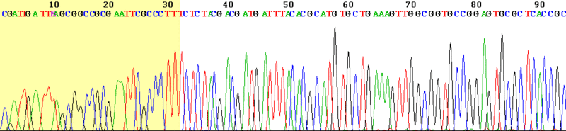
The reaction fragments (the fluorescent tagged fragments) are poured in a gel containing tube and electrophoresis is applied. The smallest fragment moves faster towards +ve end and read by the laser. The next larger fragment will follow it.
Laser excites the dye and the camera identifies the emitted color and hence the nucleotide
Computer
THERE ARE NEWER VARIANTS BUT THE CONCEPT IS THE SAME
Camera
Laser
Author: Loris; http://en.wikipedia.org/wiki/File:Sanger_sequencing_read_display.gif
Chromatogram

Slide 21
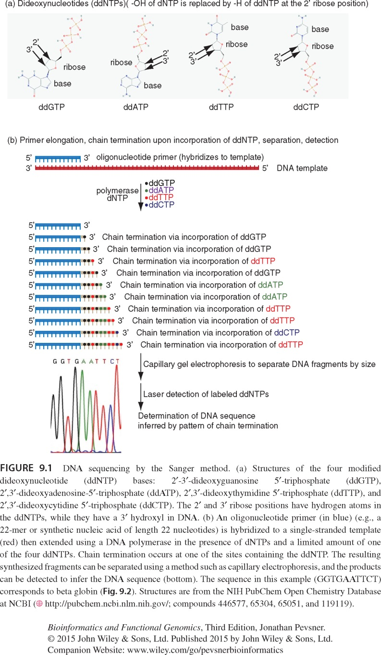

Slide 22
Sanger Sequencing
1979-2003 Dominant sequencing method
Can produce high quality reads
Error rate < 1% /base
Still used in large sequencing centers
Currently, can read 800 or more bases in one reaction

Slide 23
Example of Sanger Sequencing
NCBI
Specialized BLAST (Organism: Homo sapiens)
Restrict to Trace Archive Nucleotide BLAST; DB: Homo sapiens
From the hits (hits are from Archive DB (unfinished nextgen sequencing efforts)
From the hits (accesssion) you can go directly to the Trace Archive DB to see the quality in a color format

Slide 24
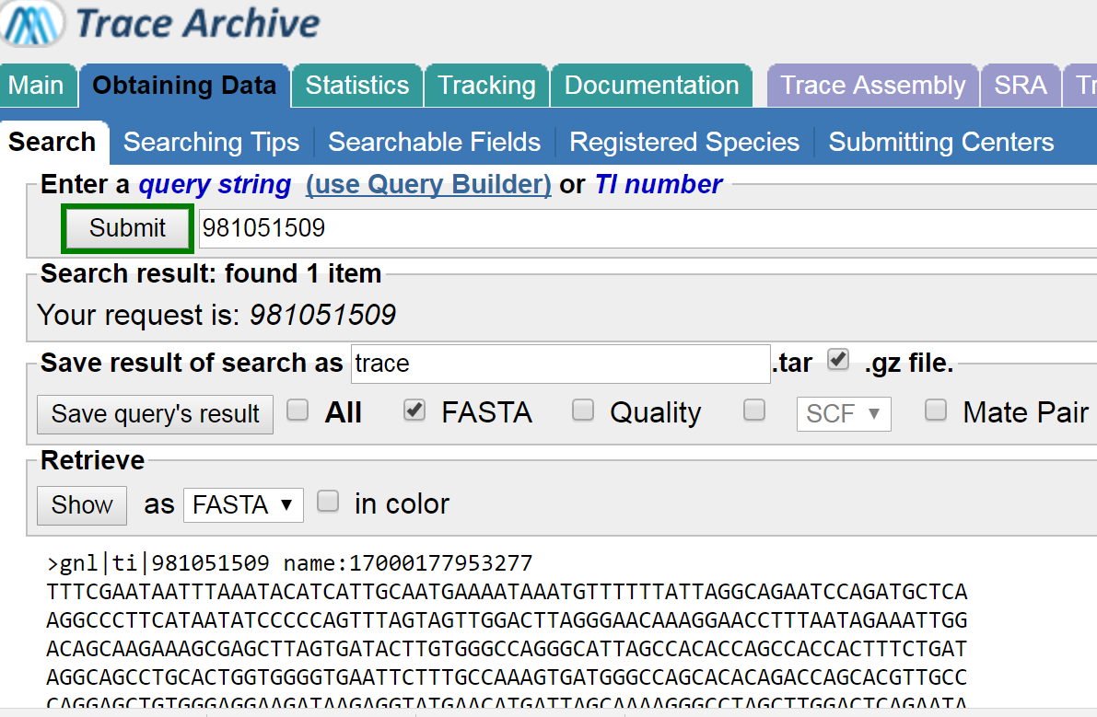
Sanger Sequencing
Sequencing read is called a trace
Sequences are stored in a database (NCBI) called Trace Archive
Ex 981051509
Let us take a different route to get here via BLAST

Slide 25
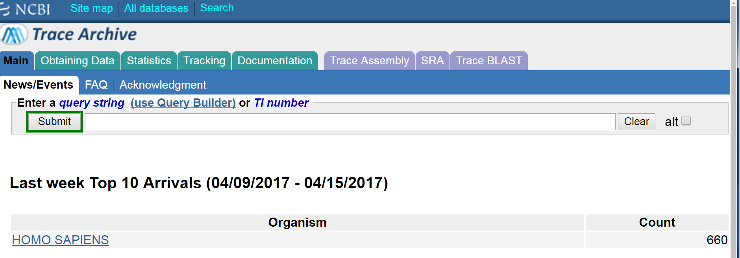

Slide 26
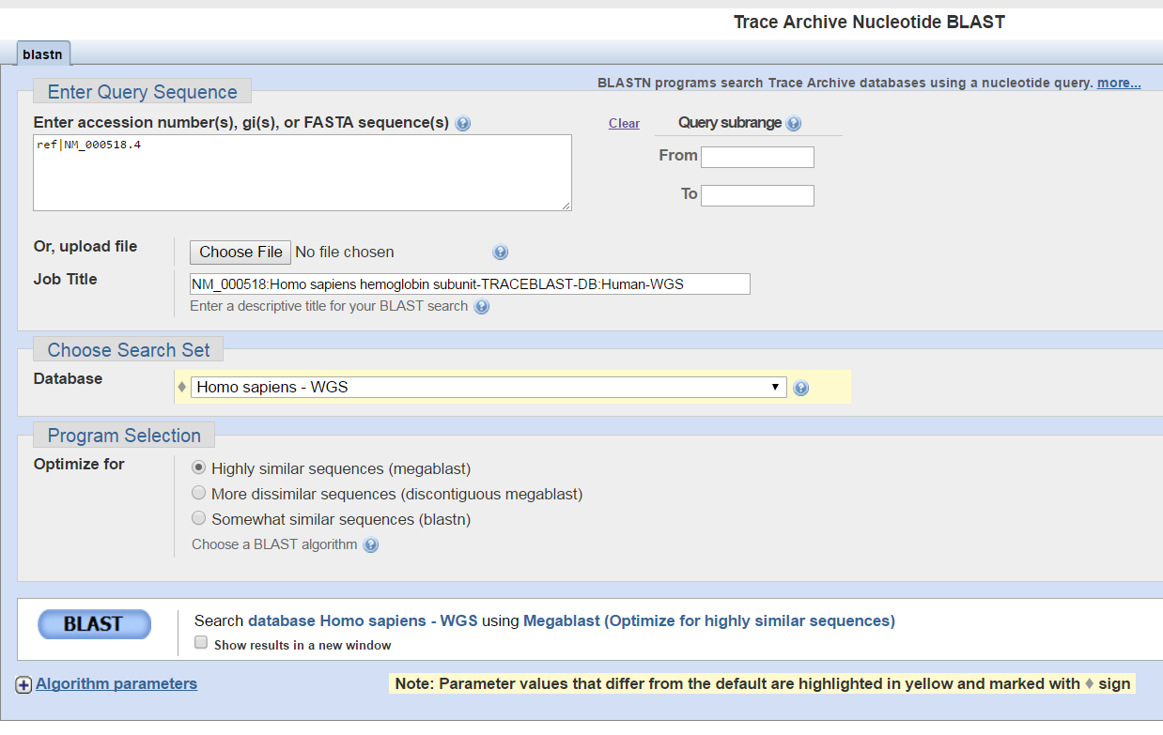
NM_000518.4
Human-WGS
MEGABLAST

Slide 27
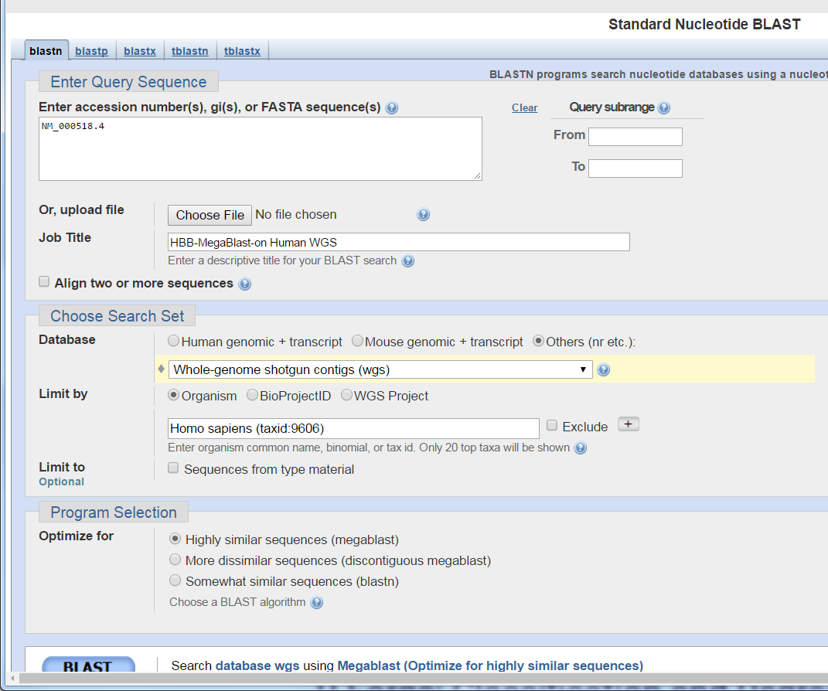
NM_000518.4
Human-WGS
MEGABLAST

Slide 28
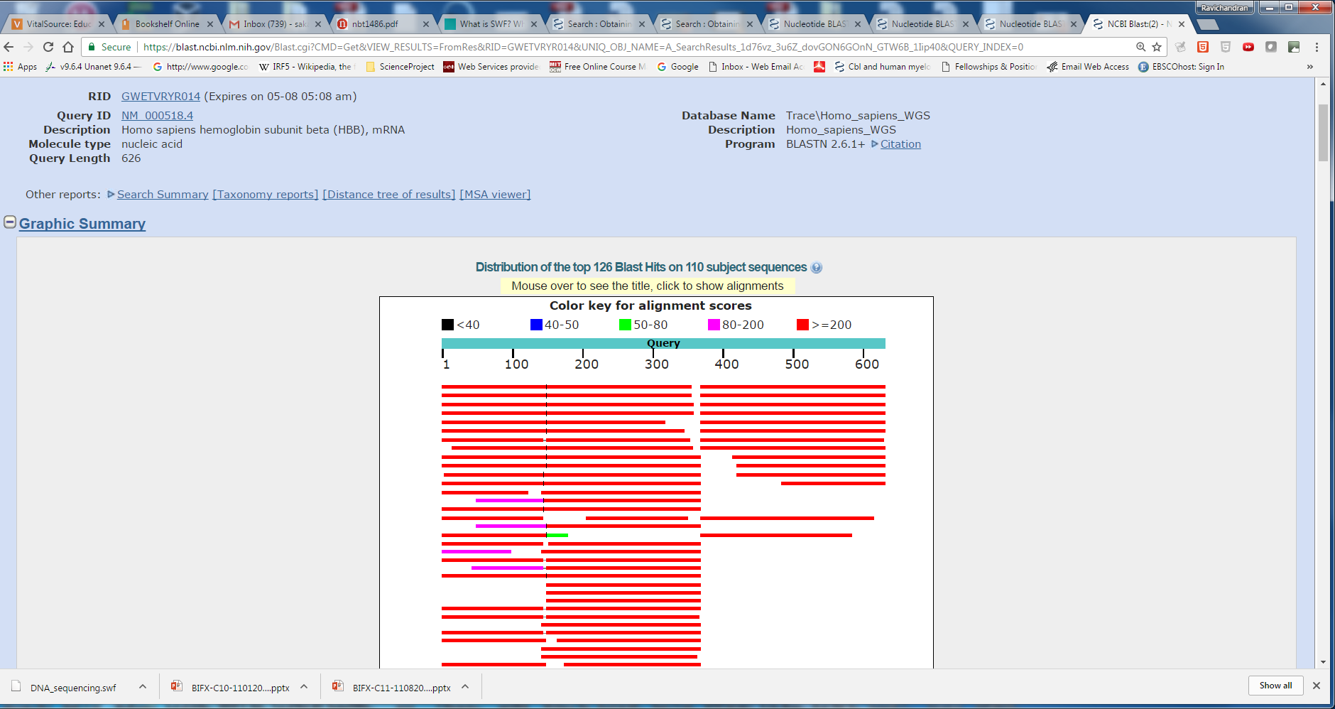

Slide 29
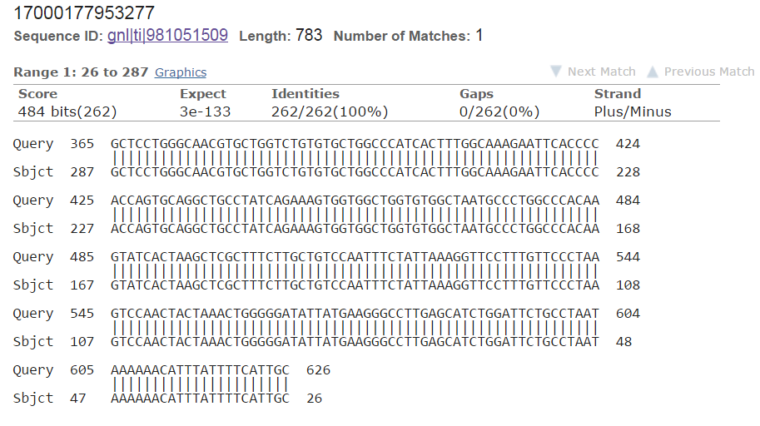
Alignment of SRA sequence to HBB

Slide 30
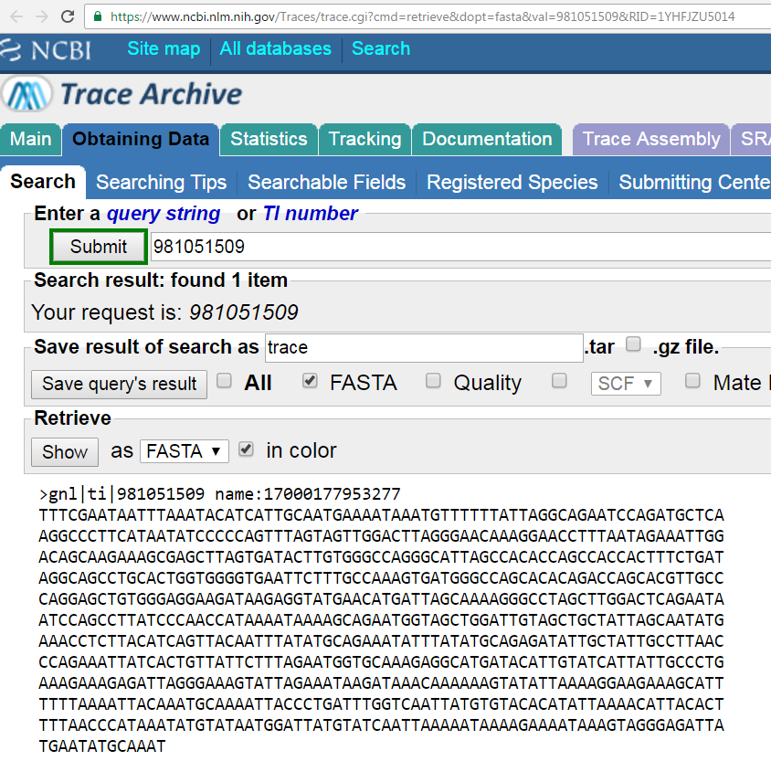
Sample Trace Sequence

Slide 31
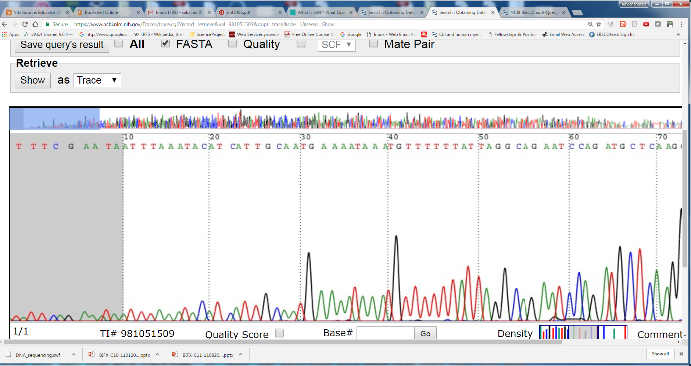
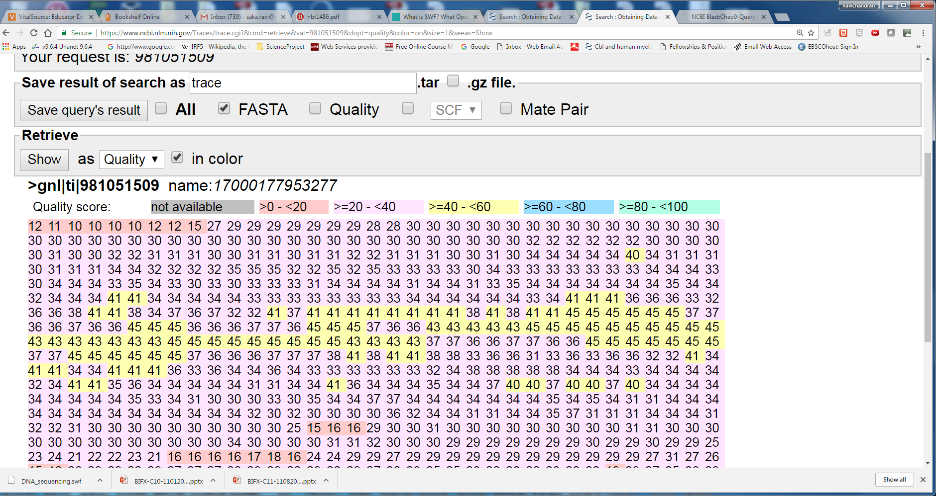
Q = -10 log₁₀ P
At a quality score of 20 (Q20) there is a
10^-2 or 1% error rate
Scores below Q20 are suspect

Slide 32
More on Phred Scores
Phred scores
Phred Quality Score Prob of incorrect base call Base call accuracy
10 1 in 10 90%
20 1 in 100 99%
60 1 in 1M 99.9999%

Slide 33
Compare Sanger with NGS Sequencing

Slide 34
NGS
WGS
A name applied to New & Powerful sequencing technologies developed in the last 10 years
Popular platforms are PacBio, Illumina, IonTorrent
Early days of WGS
35–50 base pairs,
As of Recent days
hundreds of base pairs.
Note PacBio can handle thousands of base pairs.
This can be extraordinarily important in resolving duplicated regions and in genome assembl

Slide 35
NGS
WGS
sequencing reads
Millions to Billions
Illumina can produce roughly 1TB or more of data per run (HiSeq technology)
The time required for a run
Hours to days.
The cost HGP
US$ 1–3 billion over a 15 year period,
Today can be whole-genome sequence < $2K
Each technology introduces different, characteristic types of errors that influence the variants that are called at the end of the data analysis pipeline.

Slide 36
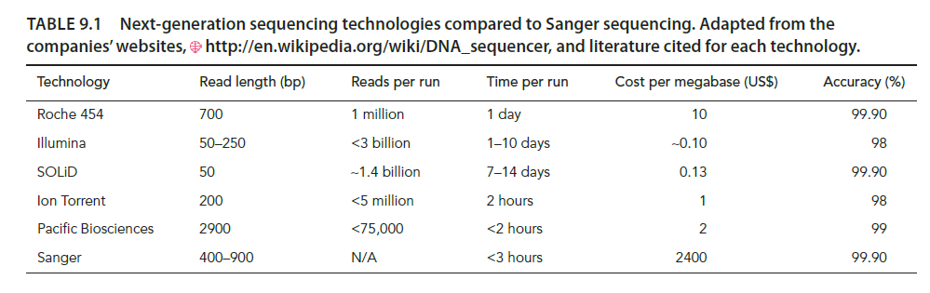
Table 9.1 from the Book

Slide 37
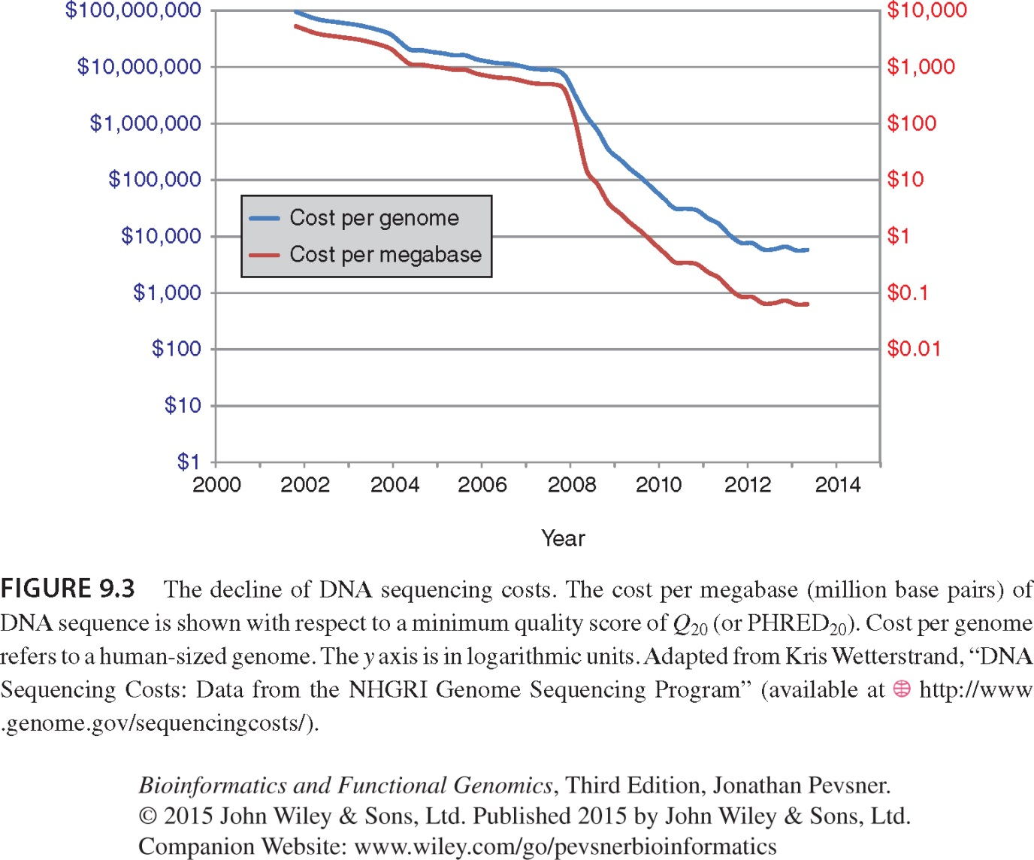

Slide 38
Watch the Video in the class
https://www.youtube.com/watch?annotation_id=annotation_228575861&feature=iv&src_vid=womKfikWlxM&v=fCd6B5HRaZ8

Slide 39
Illumina steps
Cycle reversible termination
Genomic DNA is randomly fragmented
Sonication, shearing etc
Adapters are attached to both ends and covalently attached to the flow cell channels
DNA polymerase and unlabeled deoxynucleotides added
U shaped loops are created; they are denatured and amplifed to generate dense clusters of DNA

Slide 40
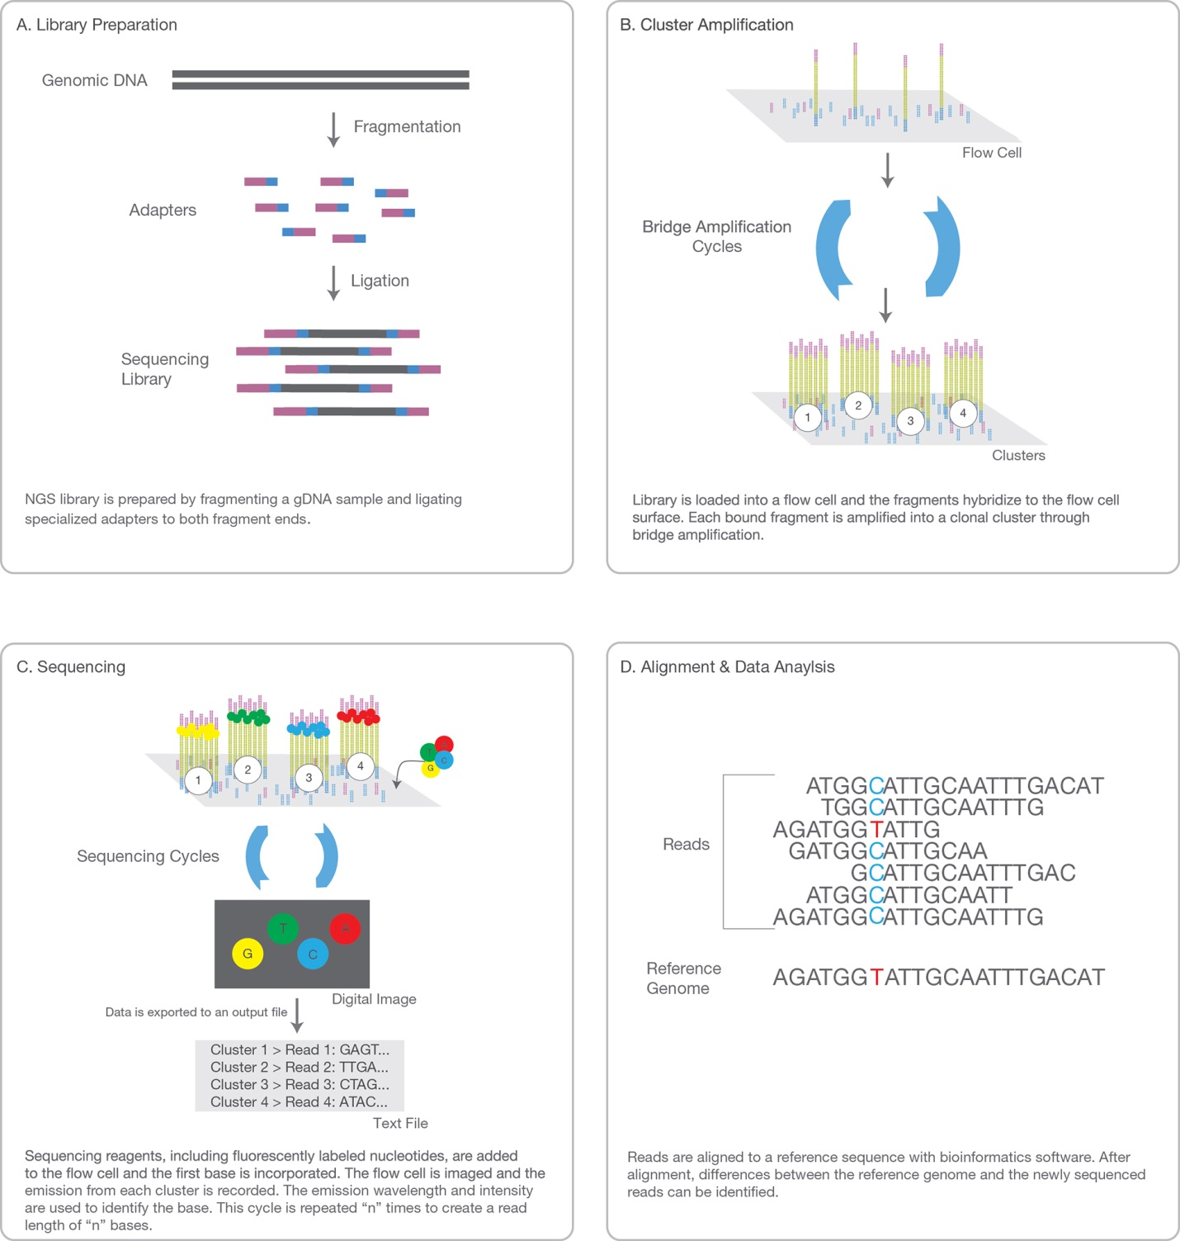

Courtesy of Illumina, Inc. Copyright Figure

Slide 41
NextGen
Cluster 1
Reads

Slide 42
Technologies
Illumina
IonTorrent
Do not make use of optical signals; pH based;
Higher error rate
PacBio
Mean fragment length of sequence is about 15kb
Unlike Illumina, it can generate longer reads
More expensive than Illumina
Nanopore

Slide 43
Technologies
PyroSequencing
Becoming very popular; accurating sequencing with extremely low error rates

Slide 44
Other Sequencing Methods
Pyrosequencing
Alternative approach to Illumina
Uses a Bead based approach instead of a “flow cell”
Sequencing by Ligation
Library preparation
Bead coupling → PCR amplification
Bead deposition on glass slide
Sequencing by ligation
Data Analysis (repeat steps 1 to 5 many times)

Slide 45
Next Gen Seq. technology: Applications
1000 Genomes Project
HEP
How do go from sequence reads to applications?
Step1 answers the question for each read,
where does this read came from?

Slide 46
Reads matched to Reference
Reads (NTs are not shown)
Mapping to Reference Genome
Reference
CTCTGGTCGAGGGTCTAAATCGCCCCTGTGTACCCGGGTAGAGAGAGACCAG

Slide 47
NGS Application: Variant Detection
READS
READS
READS
GTCGCAGTANCTGTCT |||||||||||||||| GTCGCAGTATCTGTCT
Pile-up:
The collection of NTs from each read at a particular location
Align to the Reference
GGATCTGCGATATACC ||||||||||||||||
GGATCT-CGATATACC
Aggregate/Pile-up
TCTCTCCCANNAGAGC ||||||||||||||||
TCTCTCCCAGGAGAGC
Statistics

Slide 48
NGS Application: RNA-seq differential expression (RNA not DNA)
Take RNA→ cDNA and sequence them
Sample A
Reads
Aggregate
Align
Pile-up
GeneX
Reference
CTCTGGTCGAGGGTCTAAATCGCCCCTGTGTACCCGGGTAGAGAGAGACCAG
Sample B
Reads
Align
Aggregate
Statistics
Pile-up
GeneX is expressed more in Sample A than B

Slide 49
NGS Application: ChIP-seq
READS
THAT CONTAINED THE BOUND PROTEIN
Align to the Reference
Aggregate/pile-up
Peak Detectors
Reference
CTCTGGTCGAGGGTCTAAATCGCCCCTGTGTACCCGGGTAGAGAGAGACCAG
Statistics
Binding occurs at this site; Hyp Testing; P-value 0.0023

Slide 50
Analysis of NGS of Genomic DNA

Slide 51
Commonly used workflow is the Genome Analysis Toolkit (GATK)

Slide 52
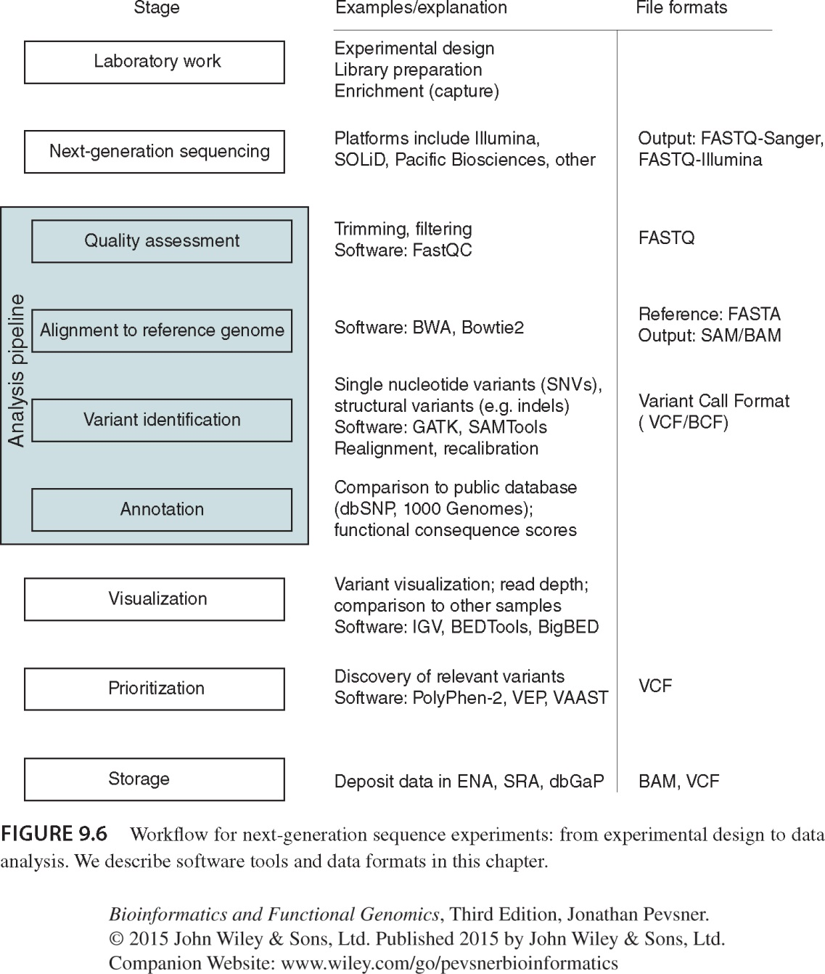
FASTQ-Sanger/ FASTQ-Illumina
SAM/BAM
VCF/BCF

Slide 53
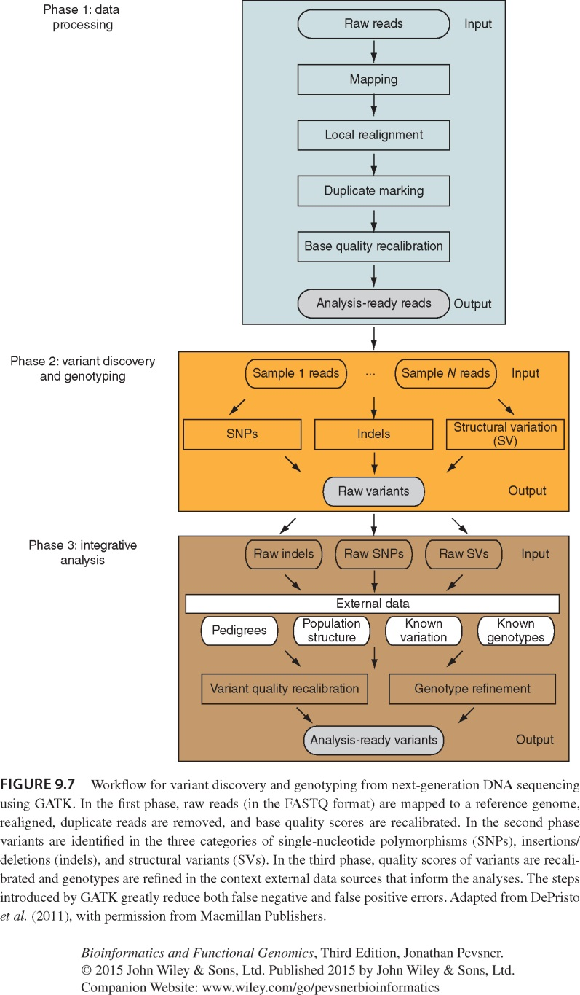
GATK: Genome Analysis Toolkit state-of-the-art workflow

Slide 54
Sequencing Project Steps

Slide 55
1. Sample Data
Two steps
Sample Preparation
WGS: DNA → fragments (~300 bp)
Whole Exome Sequencing (WES): Exonic regions are enriched (or captured) and isolated
Patient consent and privacy are important (more on this on the book)
Library Creation
5’ and 3’ Adapter ligation or paired-end sequence fragments
Insertion or deletion can be identified
Fragments are amplified and gel-purified

Slide 56
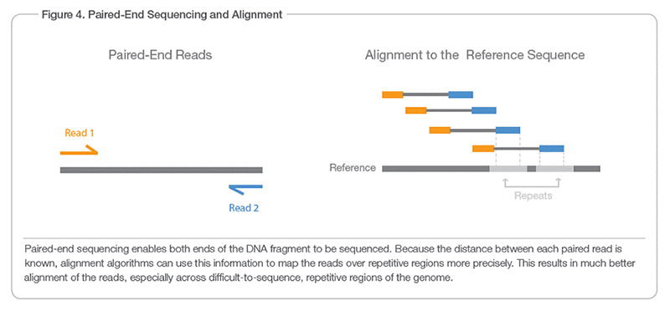
Paired-end sequencing
Copyright figure from Illumina http://www.illumina.com/technology/next-generation-sequencing/paired-end-sequencing_assay.html
Paired-end can give us clues on repeat regions and/or insertions

Slide 57
Illumina Paired-end
--------[f-180bp]---------->
-------[r1]---->
<-------[r2]----
-------------------------------------[f-350bp]--------------------->
--------[r1]----> <--------------
Assumption:
The initial DNA fragments are longer than your actual reads
You will be sequencing both its ends
The approach will result in 2 reads/fragment
(1 in forward and 1 in reverse)
Note that the forward and reverse doesn’t have to overlap
There will be 2 fastq files
One contain all “r1” reads and the second one will contain “r2” reads
For example,
If the second read
Says,
ATGCCCG
It means
CGGGCAT in the forward direction

Slide 58
Paired-end (or closely related mate-pair) reads
File 1
@M02286:19:000000000-AA549:1:1101:12677:1273 1:N:0:23
CCTACGGGTGGCAGCAGTGAGGAATATTGGTCAATGGACGGAAGTCT
+
ABC8C,:@F:CE8,B-,C,-6-9-C,CE9-CC--C-<-C++,,+;CE
@M02286:19:000000000-AA549:1:1101:15048:1299 1:N:0:23
CCTACGGGTGGCTGCAGTGAGGAATATTGGACAATGGTCGGAAGACT
+
ABC@CC77CFCEG;F9<F89<9--C,CE,--C-6C-,CE:++7:,CF
File 2
@M02286:19:000000000-AA549:1:1101:12677:1273 2:N:0:23
CACTACCCGTGTATCTAATCCTGTTTGATACCCGCACCTTCGAGCTTA
+
--8A,CCE+,,;,<CC,,<CE@,CFD,,C,CFF+@+@CCEF,,,B+C,
@M02286:19:000000000-AA549:1:1101:15048:1299 2:N:0:23
CACTACCGGGGTATCTAATCCTGTTCGCTCCCCACGCTTTCGTCCATC
+
-6AC,EE@::CF7CFF<<FFGGDFFF,@FGGGG?F7FEGGGDEFF>FF
Note the same ID in both read files
Interleaved (both in one file)
@1/1
AGGGATGTGTTAGGGTTAGGGTTAGGGTTAGGGTTAGGGTTAGGGTTA
+
EGGEGGGDFGEEEAEECGDEGGFEEGEFGBEEDDECFEFDD@CDD<ED
@1/2
CCTAACCCTAACCCTAACCCTAACCCTAACCCTAACCCTAACCCTAAC
+
GHHHDFDFGFGEGFBGEGGEGEGGGHGFGHFHFHHHHHHHEF?EFEFF
@2/1
AGGGATGTGTTAGGGTTAGGGTTAGGGTTAGGGTTAGGGTTAGGGTTA
+
HHHHHHEGFHEEFEEHEEHHGGEGGGGEFGFGGGGHHHHFBEEEEEFG
@2/2
CCTAACCCTAACCCTAACCCTAACCCTAACCCTAACCCTAACCCTAAC
+
HHHHHHHHHHHHHGHHHHHHGHHHHHHHHHHHFHHHFHHHHHHHHHHH

Slide 59
2. Generating FastQ from sequence data
Image files usually come out of the sequencer
The image files for reads are converted into numbers and written in a file format called FASTQ
Very similar to fasta file
Each file contains information about the reads with quality scores

Slide 60
Available from Book website
Demo of FASTQ files

Slide 61
FASTQ (Sanger to NextGen)
@SEQ_ID GATTTGGGGTTCAAAGCAGTATCGATCAAATAGTAAATCCATTTGTTCAACTCACAGTTT + !''*((((***+))%%%++)(%%%%).1***-+*''))**55CCF>>>>>>CCCCCCC65
ASCII format
Line 1: begins @ character and other details (sequence ID etc) are optional
Line 2: raw sequence of the read
Line 3: begins with “+” and optionally by same sequence ID

Slide 62
To understand the quality scores, we need to understand ASCII codes

Slide 63
Nucleotide Symbols
A, T, G, C
R = G/A (purine)
Y = C/T (Pyrimidine)
M = A/C
K = G/T
S = C/G
W = A/T
H = A/C/T not G
B = C/G/T not A
V = A/C/G not T
D = A/G/T not C
N = A/C/G/T

Slide 64
Scores
Three types of scores
Sanger standard format (commonly used)
Often called Q or PHRED scores
Introduced by Phil Green (1998)
Solexa (now Illumina Inc.) since 2004
Illumina 1.3+ FASTQ format

Slide 65
Let us focus on Standard Sanger Scores
Scores are stored as ASCII printable characters 33-126
ASCII offset of 33 (why 33-126, more on next page)
Range of possible quality score is 0-93
126-33 = 93

Slide 66
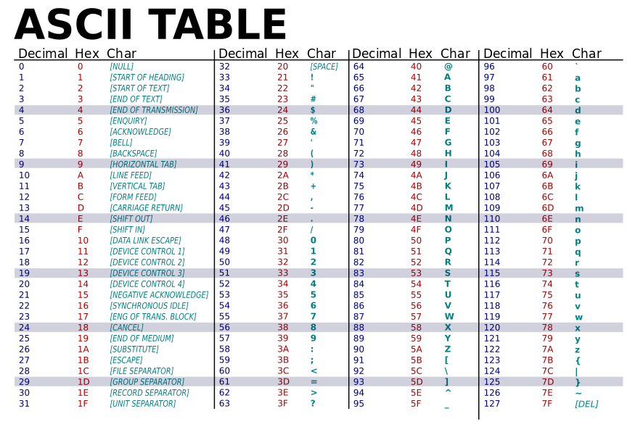
Public Domain Figure from http://simple.wikipedia.org/wiki/ASCII Author: LanoxxthShaddow (ASCII-Table.svg: ZZT32)

Slide 67
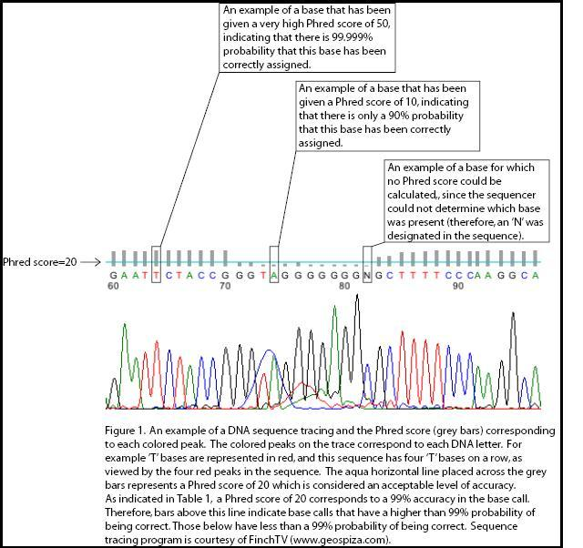
https://en.wikipedia.org/wiki/File:Phred_Figure_1.jpg
Author: Roseisis
Phred Quality Scores (Q) Error Probabilities (P)

Slide 68
Phred Quality Score | Probability of incorrect base call | Base call accuracy
10 | 1 in 10 | 90%
20 | 1 in 100 | 99%
30 | 1 in 1000 | 99.9%
40 | 1 in 10,000 | 99.99%
50 | 1 in 100,000 | 99.999%
60 | 1 in 1,000,000 | 99.9999%

Slide 69
@SEQ_ID GATTTGGGGTTCAAAGCAGTATCGATCAAATAGTAAATCCATTTGTTCAACTCACAGTTT + !''*((((***+))%%%++)(%%%%).1***-+*''))**55CCF>>>>>>CCCCCCC65
FASTQ (ASCII format)
Line 4: quality values same number as line 2. Probability of error during the sequencing
Two types of quality summary standards are in common practice
Sanger (PHRED +33)
Subtract 33 from the numeric value associated with the ASCII character
@ Dec value of 64; so Q = 64 – 33 = 31
Solexa (PHRED +64)
Subtract 64 from the score
Q = 64 – 64 = 0
Q = -log₁₀P

Slide 70
@SEQ_ID GATTTGGGGTTCAAAGCAGTATCGATCAAATAGTAAATCCATTTGTTCAACTCACAGTTT + !''*((((***+))%%%++)(%%%%).1***-+*''))**55CCF>>>>>>CCCCCCC65
If PHRED SCORE Prob of incorrect base call Accuracy 0 1 in 1 0% 30 1 in 10 90%
Quality Scores: ‘!’ lowest and ‘~’ is the highest
If the symbol is ‘!’
QUIZ: What is the Quality score for the second base in the above read?
Assume Sanger Standard (PHRED +33) to get the Quality Scoring.

Slide 71
Quality Scores: ! Is for lowest and ~ is for the highest. Why these symbols were chosen?
Public Domain Figure from http://simple.wikipedia.org/wiki/ASCII Author: LanoxxthShaddow (ASCII-Table.svg: ZZT32)
ASCII code for ‘!’ is 33 so Q(Sanger) = 0; Q(Solexa) = 33 – 64 = -31
ASCII code for ‘~’ is 126

Slide 72
@SEQ_ID GATTTGGGGTTCAAAGCAGTATCGATCAAATAGTAAATCCATTTGTTCAACTCACAGTTT + !''*((((***+))%%%++)(%%%%).1***-+*''))**55CCF>>>>>>CCCCCCC65
FASTQ (ASCII format)
Line 4: quality values same number as line 1. Probability of error during the sequencing
FASTG is an extension of FASTQ
Qsanger = -10 log10 P and QSolexa = -10 log10 p/1-p

Slide 73
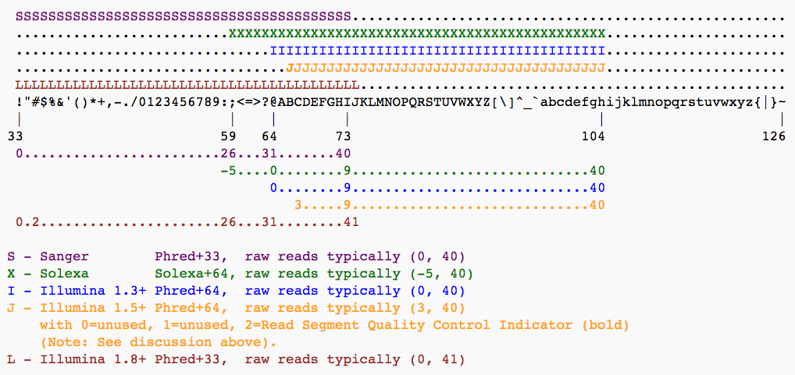
Image was taken from Galaxy.org site Starting with Illumina 1.8

Slide 74
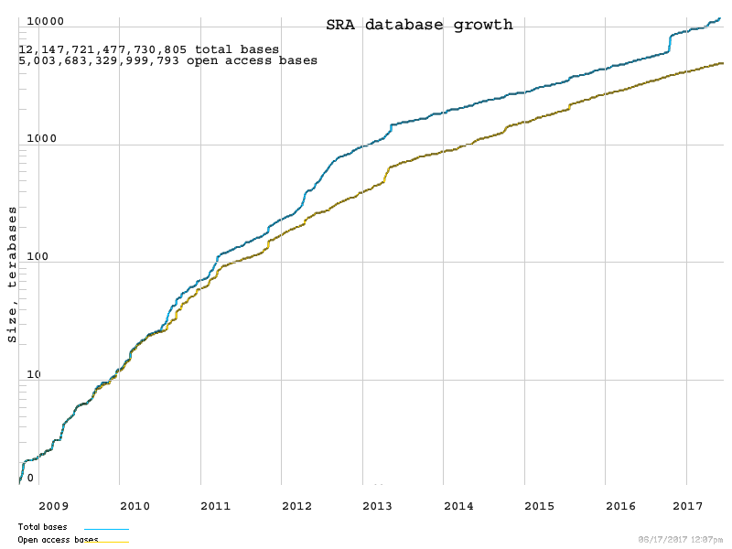
FastQ files, is there a DB?
SRA from NCBI
stores FASTQ files
Total Bases
Open access Bases
~ 5 Million Billion or ~ 5 Quadrillion

Slide 75
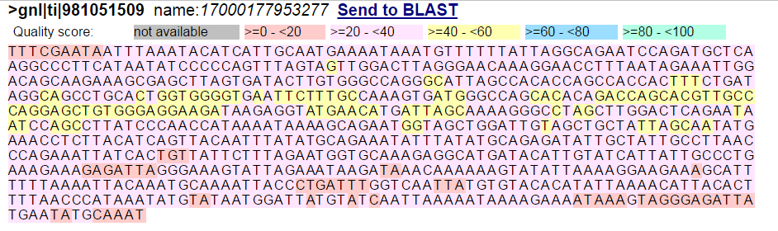
Sanger/WGS Read Example
Genomic DNA in Trace Archive from NCBI
Quality Scores (FRED)
Q20 or 20: 10^-2 or 1% error rate
Below Q20 are considered low in quality

Slide 76
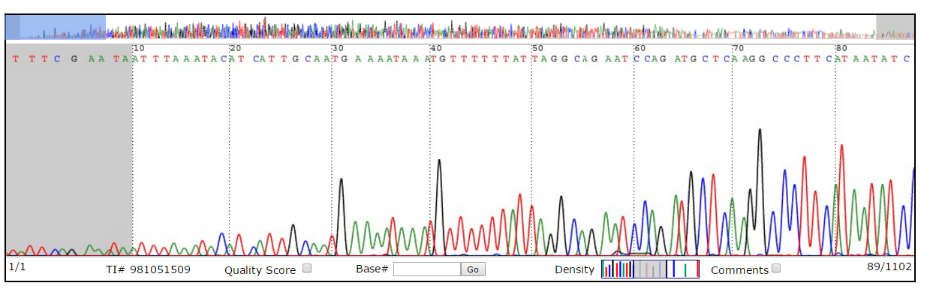
Low Quality

Slide 77
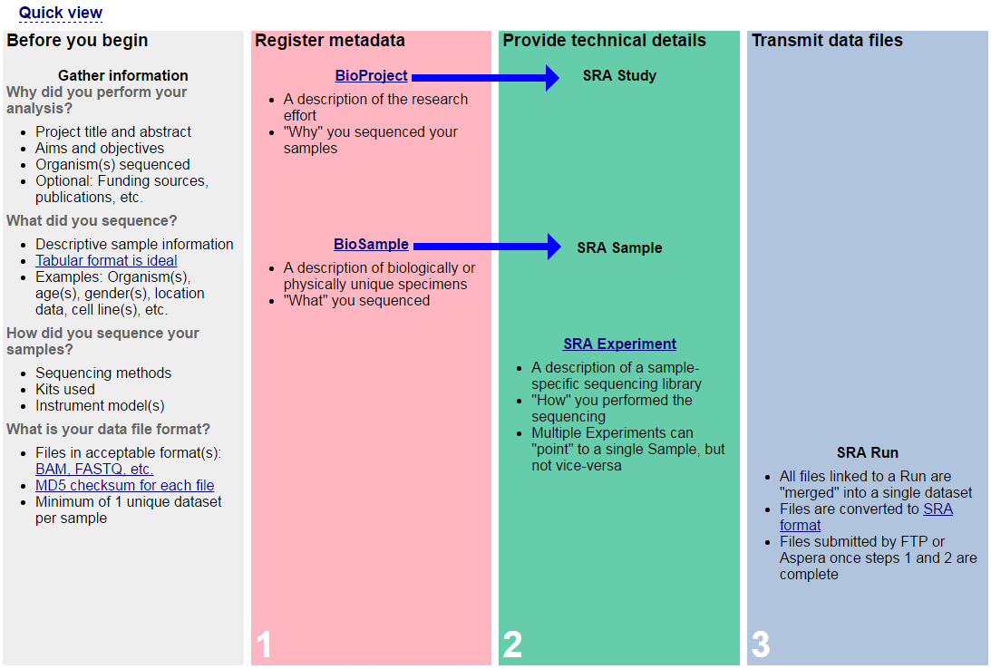

Slide 78
How to download the file:
a) install the tool-kit
b) use fastq-dump utility to download data from a typical SRA file, accession SRR390728
c) SRA Accession includes 6 other types:
SRA is an SRA submission accession. This is a virtual container holding object entries of 6 others

Slide 79
Files in SRA
SRA is an SRA submission accession. This is a virtual container holding objects from the other five types.
SRP is an SRA study accession containing project metadata, that is, a study summary.
SRX is an SRA experiment accession, including metadata, platform, and experimental details.

Slide 80
Files in SRA
SRS is an SRA sample accession describing the physical sample.
SRZ is an historical SRA analysis accession containing a sequence data file and metadata.
SRR is an SRA run accession having sequencing data such as SRR390728 that we will use.
A given experiment may have multiple runs (SRR files). We will include the argument –X 3 to specify that
we want to print just the first three spots, and –Z sends them to standard output.

Slide 81
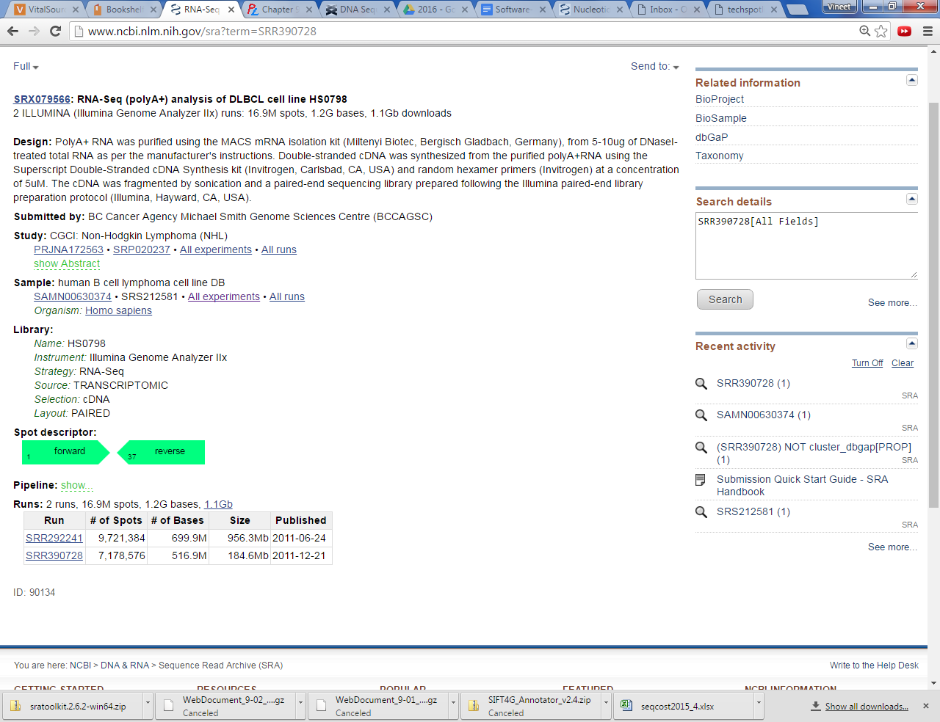
Runs: SRR* Study: SRP* Study Acc.: SRX

Slide 82
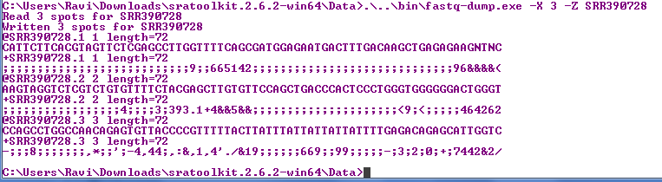
FastQ from NCBI SRA using toolkit (Windows)
-X multiple_runs ; in this case we are asking for 3 -Z Spots: In this case, we want to see the first 3 spots Spot is a definite region in the flow cell (illumine)

Slide 83
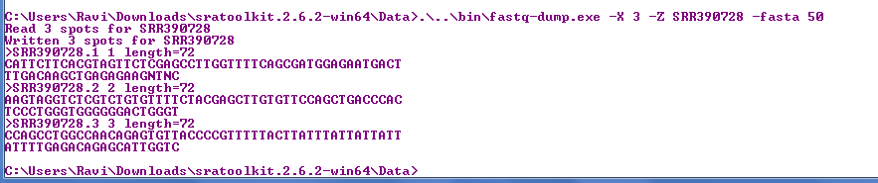
Extracting Fasta file
Fasta format with 50 columns
-X multiple_runs ; in this case we are asking for 3 -Z Spots: In this case, we want to see the first 3 spots Spot is a definite region in the flow cell (illumine) -fasta 50 : 50 characters/line

Slide 84
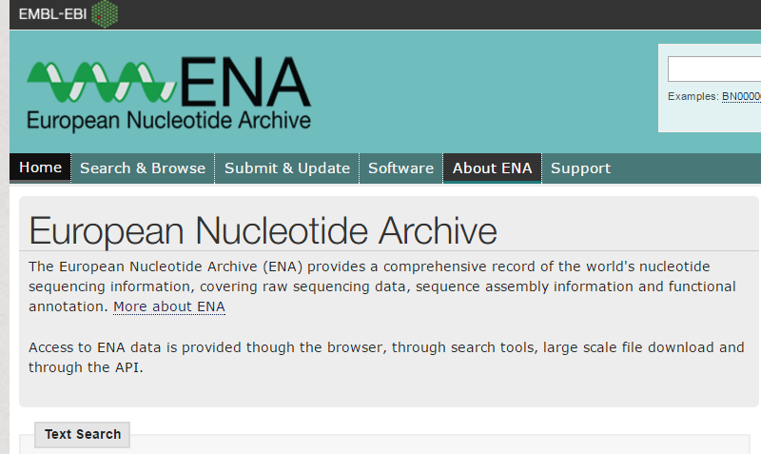
Other sources for Archive (ENA)
You can look for sequences and take it directly to Galaxy for FastQC or further analysis

Slide 85
Errors
Proportional to Read length
Illumina
As cycle continues, the technology will have trouble in identifying the base, so the quality goes down
Proportional to GC content
May occur in homopolymer positions
Ion Torrent, Pyrosequencing

Slide 86
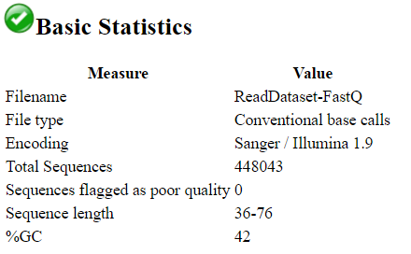
FastQC: Basic Statistics
FastQC: Quality Control software

Slide 87
FastQC
Per Base Sequence Content
“In a random library you would expect that there would be little to no difference between the different bases of a sequence run, so the lines in this plot should run parallel with each other. The relative amount of each base should reflect the overall amount of these bases in your genome, but in any case they should not be hugely imbalanced from each other.”
Overexpressed Sequences

Slide 88
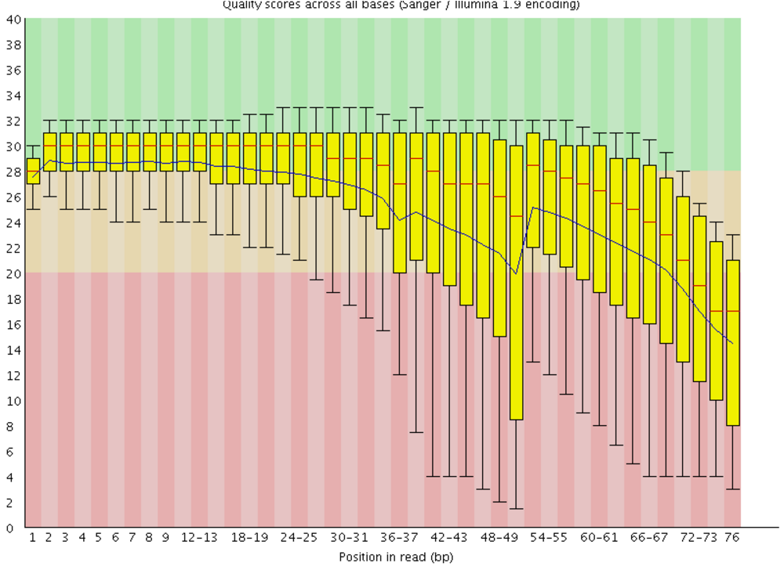
Per Base Sequence Quality
Bad Quality Example

Slide 89
FastQC
Per sequence quality scores
“In a random library you would expect that there would be little to no difference between the different bases of a sequence run, so the lines in this plot should run parallel with each other. The relative amount of each base should reflect the overall amount of these bases in your genome, but in any case they should not be hugely imbalanced from each other.”
Overexpressed Sequences

Slide 90
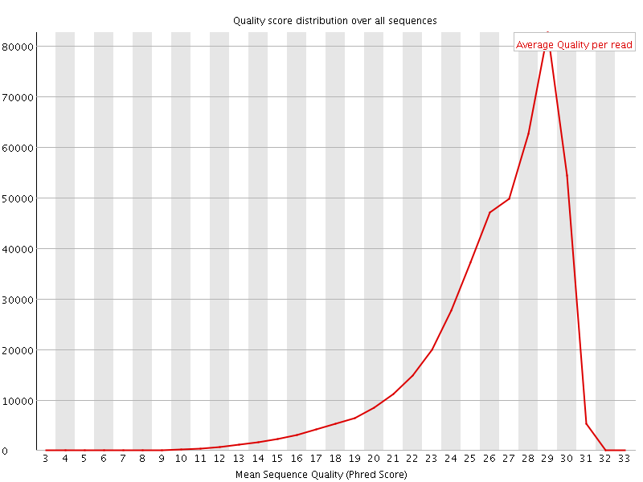
Per Sequence Quality Scores
Good

Slide 91
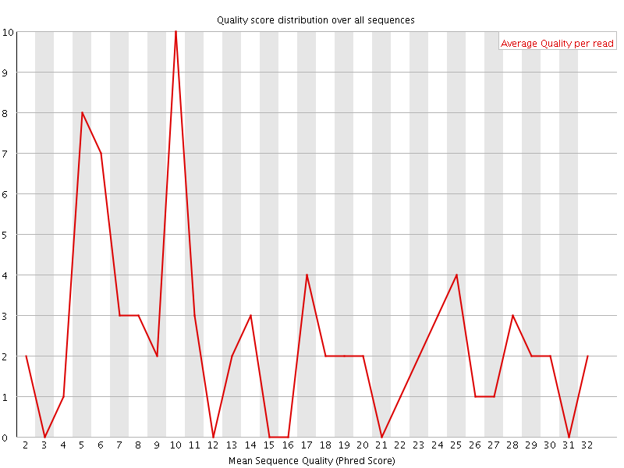
Per Sequence Quality Scores
Bad
What you want to see is one peak on high score end

Slide 92
Good/Bad FastQ
https://www.bioinformatics.babraham.ac.uk/projects/fastqc/good_sequence_short_fastqc.html

Slide 93
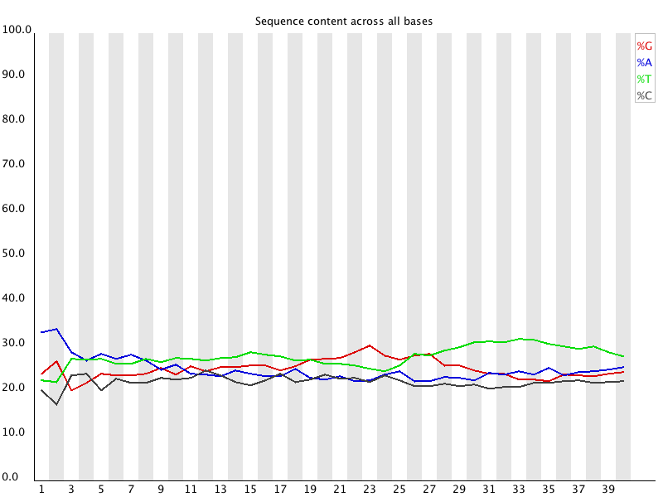
Per Base Sequence Content
Image from https://www.bioinformatics.babraham.ac.uk
What you want to see are flat lines

Slide 94
Per Base GC Content
In a random library you would expect that there would be little to no difference between the different bases of a sequence run, so the lines in this plot should run parallel with each other. The relative amount of each base should reflect the overall amount of these bases in your genome, but in any case they should not be hugely imbalanced from each other.

Slide 95
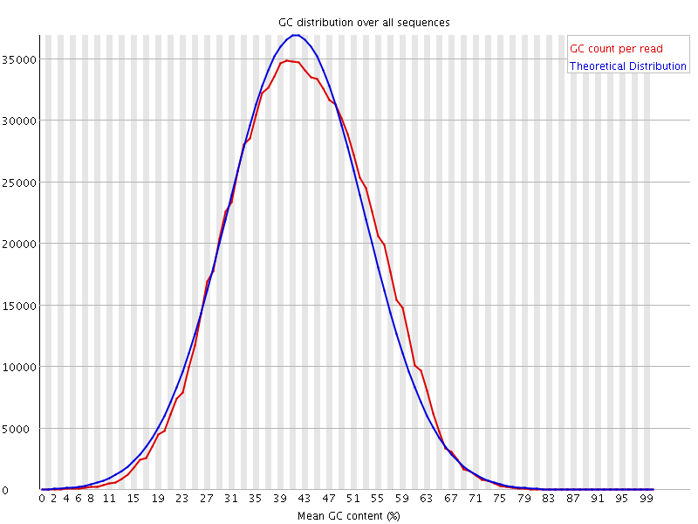
Per Sequence GC Content
Per Sequence GC content
For each sequence GC content is calculated for the whole length of each sequence and compared to a modelled normal distribution
GC Content/read

Slide 96
Others
Sequence length distribution
Reads with lengths
Adapter sequences
Sequence duplication levels
What % of my library comes from duplicated sequences
You want many unique sequences
“most of the sequences in your library only should occur once”
The peak should be at 1 and go to zero for all others
Overexpressed sequences

Slide 97
FastQC: Quality Control software
K-mer content
The expected 5-mer frequency (determined from the base composition of the entire sequence) can be compared to the observed frequency. k-mer counts may be reduced (e.g., when poor quality reads reduce the counts for duplicated sequences) or enriched (e.g., when 5-mers are overrepresented at particular location

Slide 98
FastQC: Quality Control software
Per base N content (from biof-edu.colorado.edu )
“If a sequencer is unable to make a base call with sufficient confidence then it will normally substitute an N rather than a conventional base] call”
“percentage of base calls at each position for which an N was called”

Slide 99
Hands-on using Galaxy
After the class use the tutorial document from Blackboard

Slide 100
3.Human Genome Assembly

Slide 101
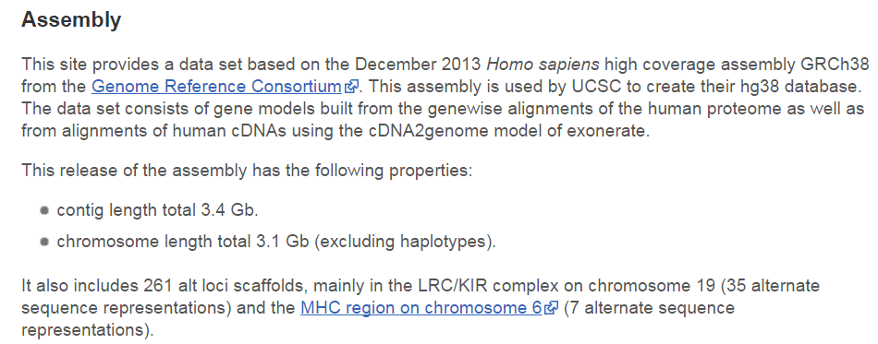
Current version GRCh38.
giga = G = 1000^3

Slide 102
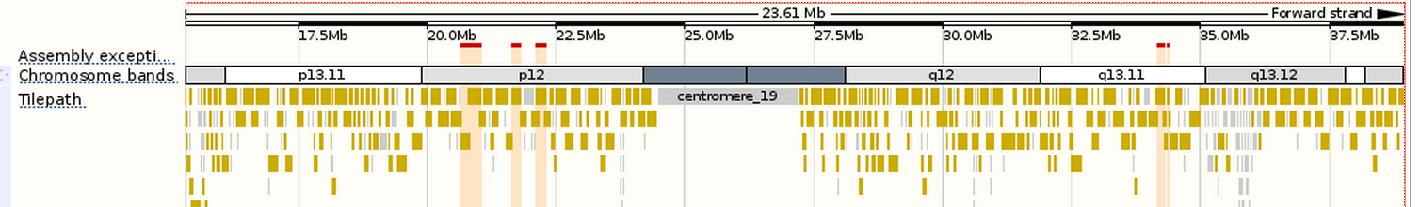
Assembly Information
Gaps between contigs
Centromere region of Chromosome 19
Repeats make sequencing difficult

Slide 103

Genome Reference Consortium

Slide 104
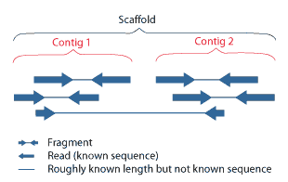
Assembly
Reads:
NextGen (stored in SRA: Sequence Read Archive)
Contigs:
Whole Genome Sequencing Made up of Reads
Scaffolds:
Consists of Contigs and gaps
Figure from http://genome.jgi.doe.gov/help/scaffolds.html

Slide 105
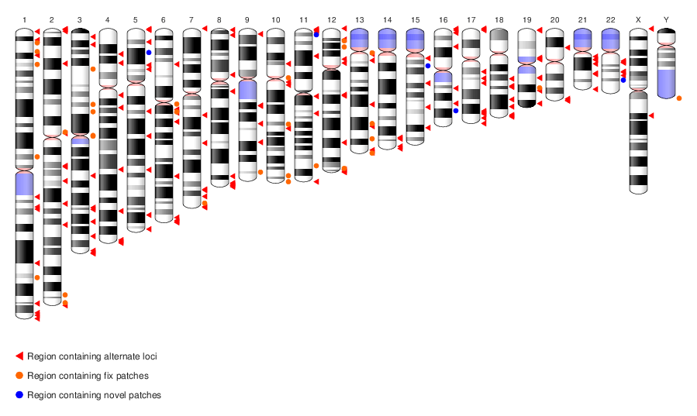
GRCh38.p3
Ideogram representation of the latest assembly
From NCBI
Why use the latest version?
GRCh38.p3 Third patch for the GRCh38 ref. Assembly
Genome Reference Consortium

Slide 106
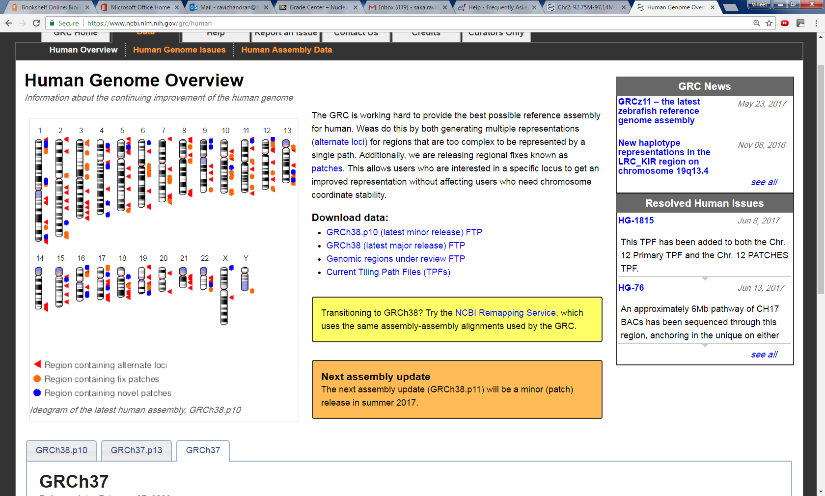
GRCh38.p10

Slide 107
GRCh??
GRCh38 (24 Dec 2013)
Mosaic
GRCh37
Build 37 is derived from 13 anonymous people (volunteers from Buffalo, NY)

Slide 108
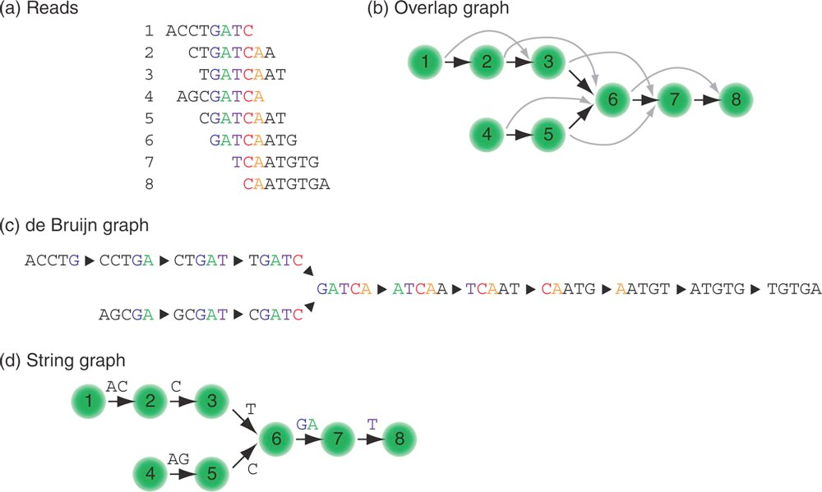
Two common methods used by assemblers

Slide 109
Competition
Assemblethon
www.assemblathon.org

Slide 110
4. Sequence Alignment
Goal: Align the reads (fastQ) to the reference genome (fasta)
Software: bowtie2
Step1: create an index file targeted101genes.fa → targeted101genes.fa.fai
Index file for human genome can be obtained from NCBI
Paired end read file (file1) and its matched paried end (file2)

Slide 111
Book site provides a sample Reference genome
What if you want to download the human genome

Slide 112
Reference Genome
Reference Genome (human)
UCSC → Downloads → Genome Data → Human → Chromosomes
NCBI
http://ftp://ftp-trace.ncbi.nih.gov/1000genomes/ftp/technical/reference/human_g1k_v37.fasta.gz
Concatenated file Chr1-Ch22 + Mitochondrial genome
http://ftp://ftp-trace.ncbi.nih.gov/1000genomes/ftp/technical/reference/human_g1k_v37.fasta.gz
800 MB

Slide 113
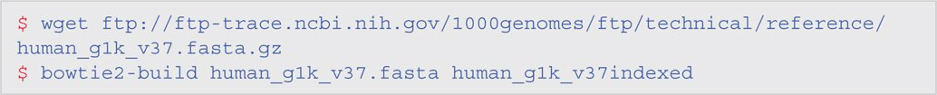
What if you don’t have the Linux server?
You can download the indexed file from NCBI
Linux Command is shown below

Slide 114
5. Sequence Alignment
Sequence Alignment Map File
Step2: bowtie2 -x index_ref_DB -1 file1.fastQ -2 file2.fastQ -s output.sam
What are the problems in aligning to the reference?
The reference has many repeats. So, the read can by mistake be alignet to wrong place.
But, if the repeats are not the same, then the quality improves

Slide 115
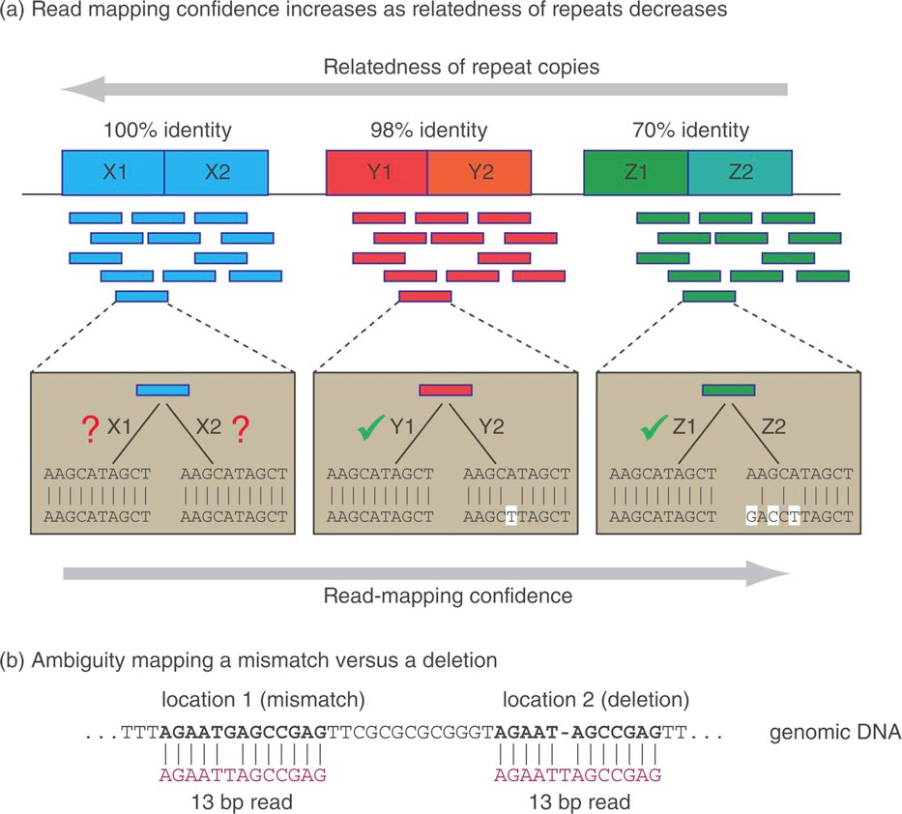
Repeats are problems

Slide 116
6. SAMTOOLS -SAM/BAM
BAM is just the binary version of SAM. So, we will just focus on SAM
What is a SAM file? Sequence Alignment Map file (read to reference) of NextGen data
How do we view or analyze the read aligned file?
SAMTools package can be used to view, convert BAM ←→ SAM, view alignments etc.

Slide 117
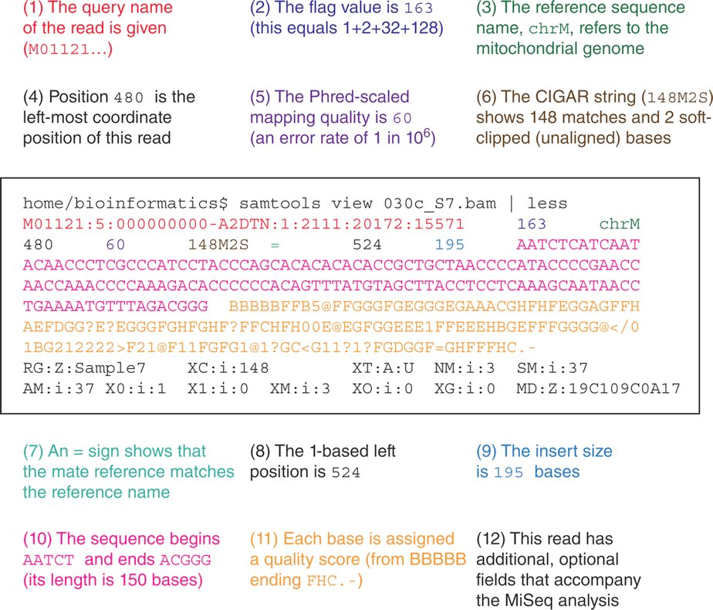
SAM File

Slide 118
Flag file 1+2+32+128
000000000001 : 1 : read paired
000000000010 : 2 : read mapped in proper pair
000000000100 : 4 : read unmapped
000000001000 : 8 : mate unmapped
000000010000 : 16 : read reverse strand
000000100000 : 32 : mate reverse strand
000001000000 : 64 : first in pair
000010000000 : 128 : second in pair
000100000000 : 256 : not primary alignment
001000000000 : 512 : read fails platform/vendor quality checks
010000000000 : 1024 : read is PCR or optical duplicate
100000000000 : 2048 : supplementary alignment

Slide 119
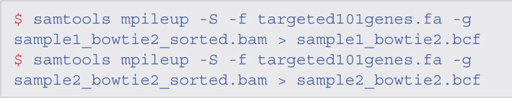
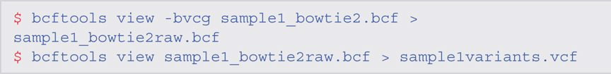
7. Variant Calling (SNP, INDELs etc.)
Using Bowtie2 to create an indel call
Produces a binary bcf file
Binary bcf → ASCII vcf file

Slide 120
8. Variant Calling: Structural Variants

Slide 121
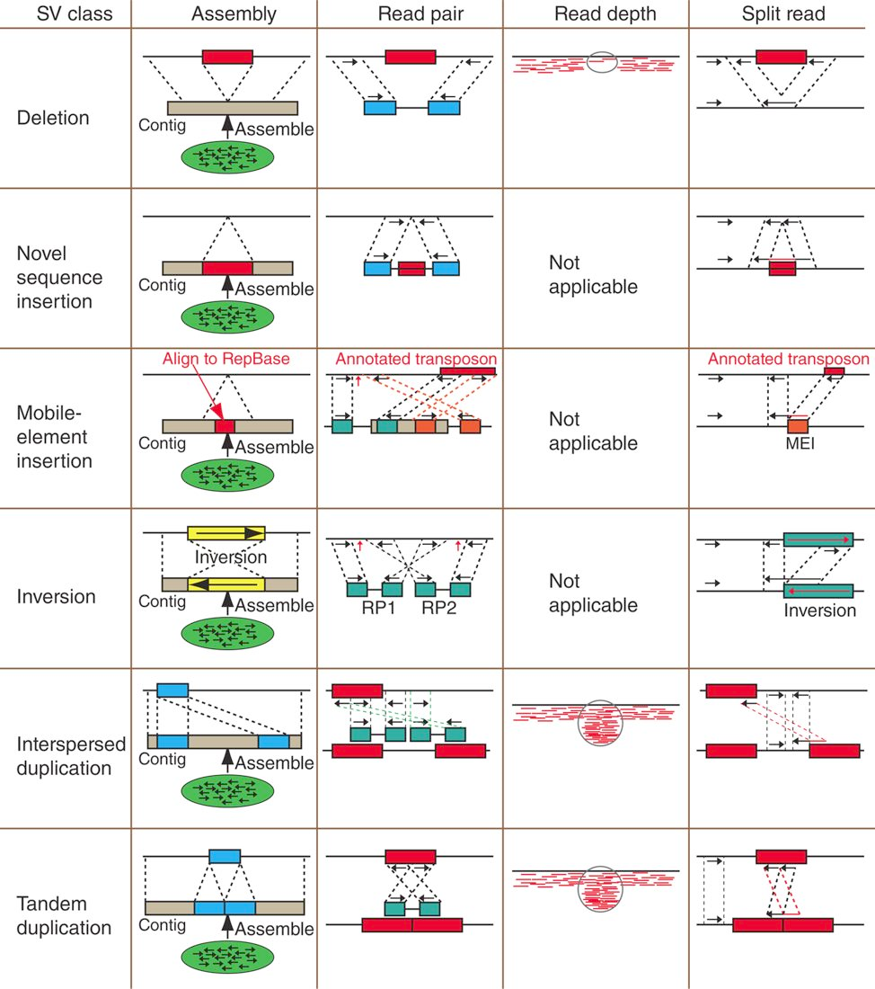

Slide 123
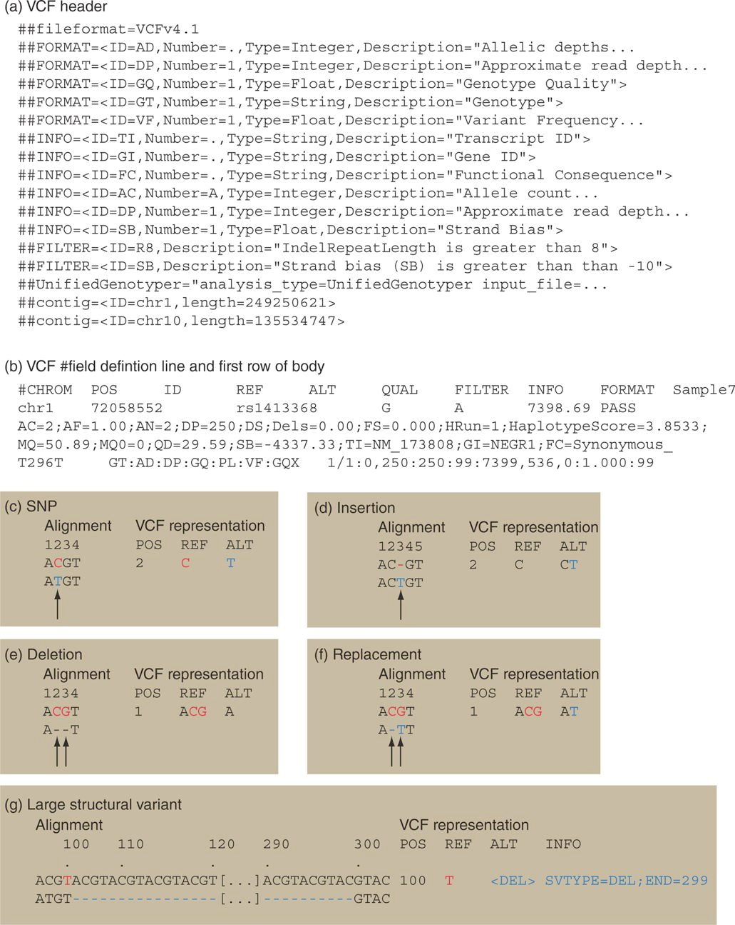
9. VCF and VCTTools

Slide 125
VCF File and what we can do with it?
Most software require a compressed VCF
So, we can compress them using linux command and feed them as input

Slide 126
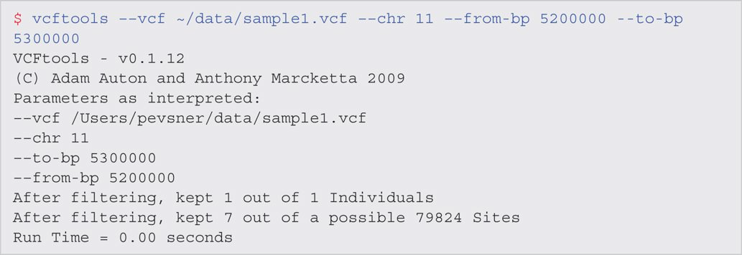
We can get stats (depth coverage etc.)
For example, using the VCF, we can ask in Chromosome 11, from mbp 5200,000 – 5,300,000 what are the variations?
This is the Beta Globin Region

Slide 127
Coverage

Slide 128
Where can we find VCF files?
1000 Genomes
Example 1
Go to ENA site
Search for ERZ015345
Send the vcf to galaxy or download
Example 2
Go to NCBI
ftp://ftp.ncbi.nih.gov/snp/organisms/human_9606/VCF/

Slide 129
10. How to visualize the variant files
SamTools and IGV are good software for visualizing the HGV data
gwbench

Slide 130
10. Biological Significance of variations
SIFT
AVIA
MutationTaster
MORE ON THESE on a future class

Slide 131
Other things to try after the class
SRA website
SRA toolkit software
FastQC Software also avail via Galaxy
Bowtie2
Index the whole human chromosome will
Linux machine with at least 8 GB of memory and many terabytes of storage)
SAMTools (library and a software)
Copy file, targeted101genes.fa from Book site

Slide 132
After Class Work
Complete the Self-test Quiz
The following are the assigned Problems/Computer Lab for this week:
9-2, 9-3
The following questions is not part of the book computer lab set
Use NA12878 or other NGS data and use a gene of your interest and do a SRA-blast

